Slide 1

Comparative Study of Machine Learning Models
Jaime Castro Cernadas
Notes:
Good [morning/afternoon/evening], everyone. My name is Jaime Castro Cernadas, and today I will be presenting my comparative study of machine learning models. This study explores how different algorithms perform on a dataset, the importance of hyperparameter tuning, and which model ultimately stands out as the best choice.

Slide 2
Hyperparameter tuning
Logistic Regression, Decision Trees, KNN, Random Forest, MLP
Validation Method: Leave-One-Out Cross-Validation
Best Parameters obtained via GridSearchCV
Notes:
In machine learning, hyperparameter tuning is a crucial step to optimize model performance. For this study, I used GridSearchCV combined with Leave-One-Out Cross-Validation, or LOOCV.
GridSearchCV systematically evaluates all possible combinations of hyperparameters to identify the best configuration for each model.
LOOCV is particularly effective for small datasets. It validates the model by training on all but one data point and testing on the remaining point, ensuring robust evaluation while avoiding overfitting.
The tuning process was applied to five models: Logistic Regression, Decision Tree, Random Forest, K-Nearest Neighbor, and Multilayer Perceptron. After tuning, the best parameters for each model were selected to maximize performance and generalization to unseen data.

Slide 3
Results
 | Training accuracy | Test Accuracy
Logistic Regression | 0.94 | 0.95
Decision Tree | 0.84 | 0.64
Random Forest | 0.94 | 0.91
KNN | 0.90 | 0.86
MLP | 0.77 | 0.82
Notes:
Now, let’s discuss the results of the tuned models. The performance of each model was evaluated using test accuracy, precision, recall, and F1-score.
Logistic Regression emerged as the best model with a 95% test accuracy. It demonstrated strong generalization and minimal errors.
Random Forest was a close second with a 91% test accuracy, performing reliably but slightly less interpretable and more complex.
K-Nearest Neighbors and Multilayer Perceptron achieved moderate accuracies of 86% and 82%, respectively.
The Decision Tree, however, underperformed with a 64% test accuracy, struggling to generalize and showing signs of overfitting.
From the confusion matrices, Logistic Regression consistently demonstrated balanced performance with minimal misclassifications, while the Decision Tree had significant errors in classifying both positive and negative instances.

Slide 4
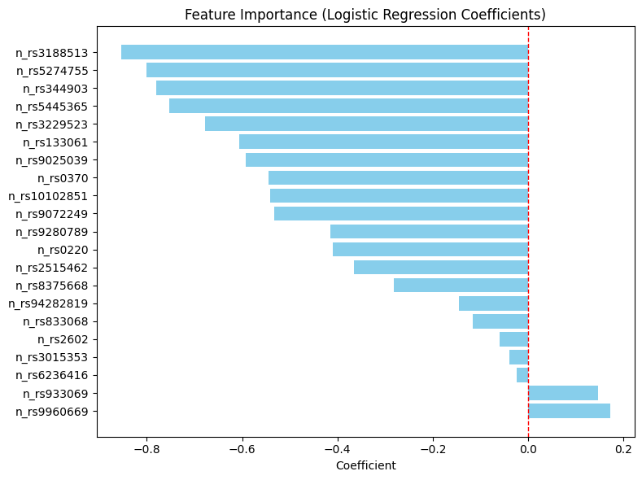
Interpreting Models: Linear Regression
Notes:
Let’s now look at the feature importance in Logistic Regression.
In this model, feature importance is derived from the coefficients. Features with higher absolute values of coefficients have a greater influence on predictions.
Key influential features with negative impact: n_rs3188513, n_rs5274755, and n_rs344903 significantly reduce the odds of the positive class.
Features with positive coefficients, such as n_rs933069, slightly increase the likelihood of the positive class.
Some features, like n_rs3015353, have negligible impact and could potentially be removed to streamline the model without sacrificing accuracy.
The insights gained from this analysis not only help in improving the current model but also guide future feature engineering efforts.

Slide 5
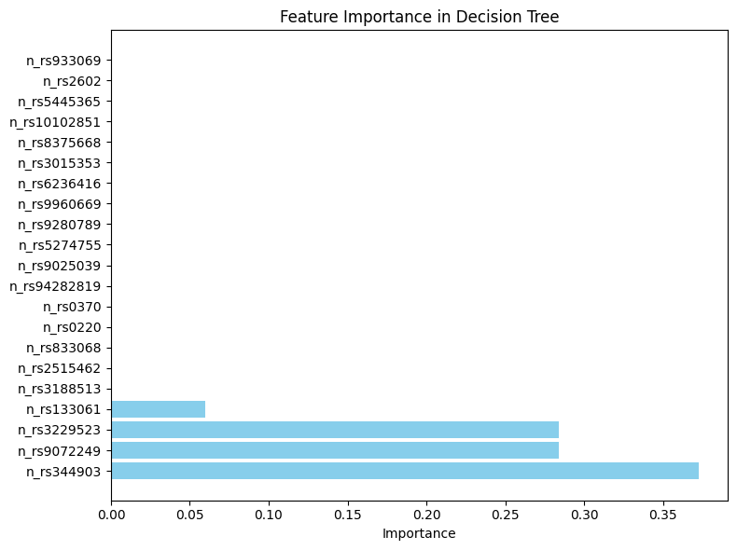
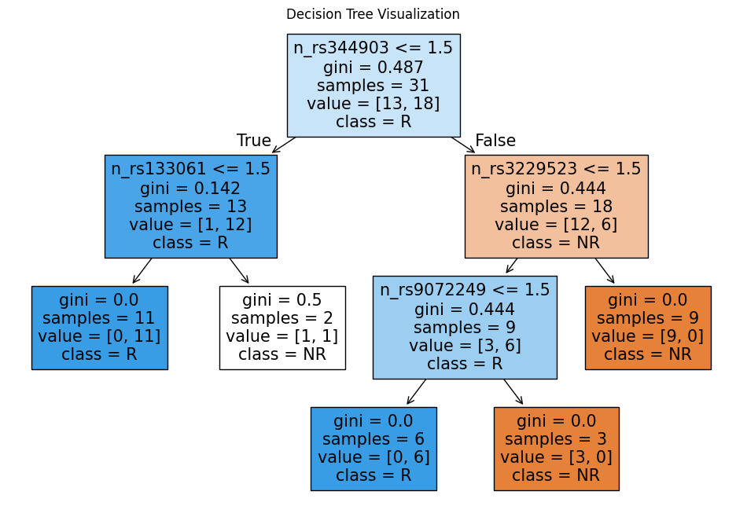
Interpreting Models: Decision Tree
Notes:
Slide 5: Interpreting Models: Decision Tree
Now, let’s examine the Decision Tree.
Tree Structure: The root split occurs at n_rs344903, which is the most influential feature. Subsequent splits use n_rs133061 and n_rs9072249 to refine the classification. Most leaf nodes achieve high purity, separating the classes effectively.
Feature Importance: The key features driving the tree are n_rs344903, n_rs3229523, and n_rs9072249. However, many features contribute minimally, suggesting the model might rely too heavily on a few dominant features.

Slide 6
Best Model: Logistic Regression
Logistic Regression has the highest accuracy (95%)
Strong generalization and simplicity make it ideal.
Notes:
Slide 6: Best Model: Logistic Regression
After evaluating all models, Logistic Regression stands out as the best choice.
It achieved the highest test accuracy of 95%, demonstrating excellent generalization to unseen data.
Its simplicity and interpretability make it ideal for practical deployment and easy to explain to stakeholders.
While Random Forest was a strong contender with 91% accuracy, it is more complex and computationally intensive, making Logistic Regression the more efficient and favorable option.
Other models, such as Decision Tree, KNN, and MLP, were less reliable due to either overfitting or lower accuracy.
For this dataset, Logistic Regression provides the best balance of accuracy, robustness, and operational efficiency.

Slide 7
Thank you for your attention
Notes:
In conclusion, this study highlights the importance of hyperparameter tuning and model evaluation. Logistic Regression emerged as the optimal model due to its simplicity, reliability, and strong performance.

